Slide 1







Twitter Sentiment analysis for 2020 US Presidential Candidates
By Akshay Punwatkar

Slide 2
Objectives
To determine the Sentiments for each of the 6 candidates
To check whether sentiments from tweets are biased to a device or not.
To determine state wise sentiments distributions for candidates.
Compare sentiment analysis using two different methods

Slide 3
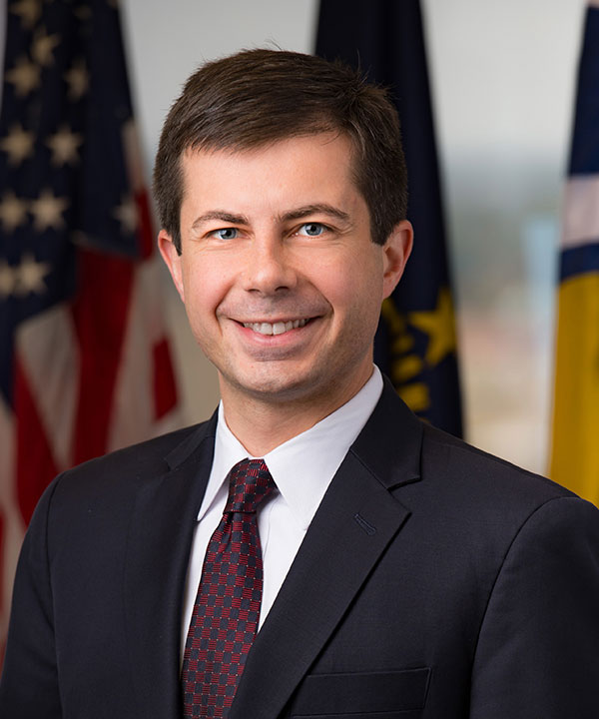
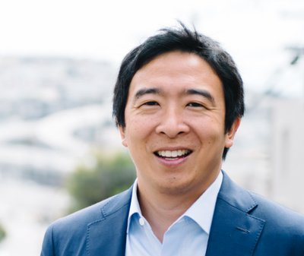
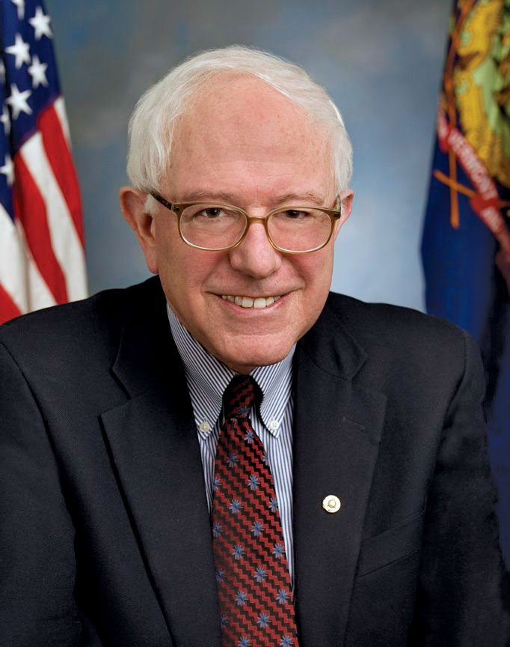
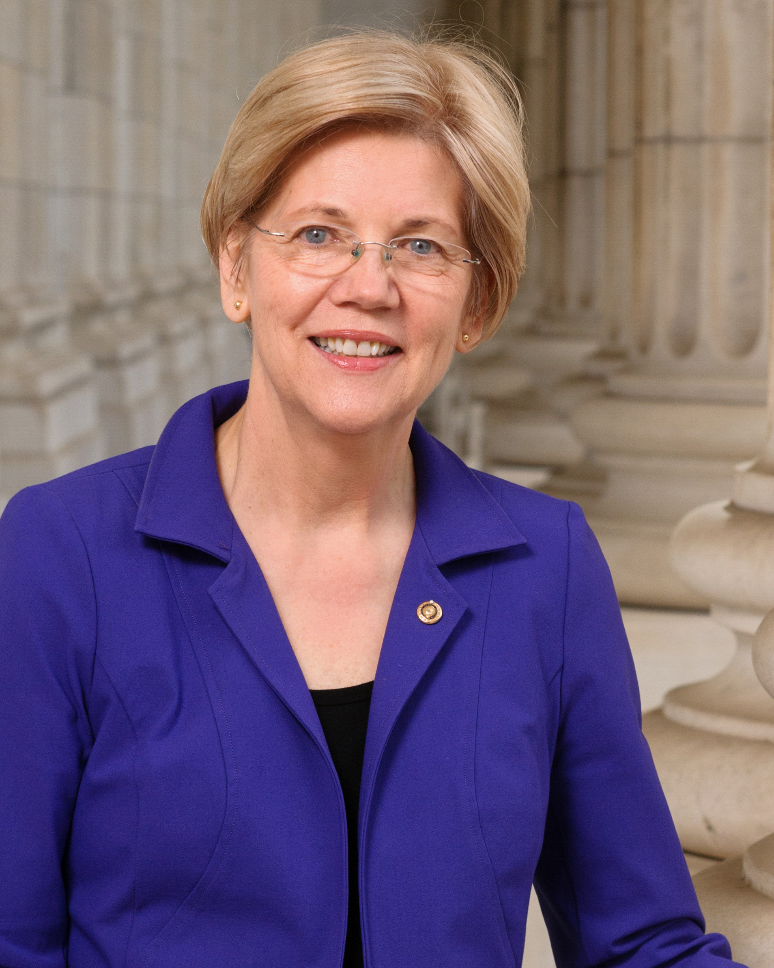
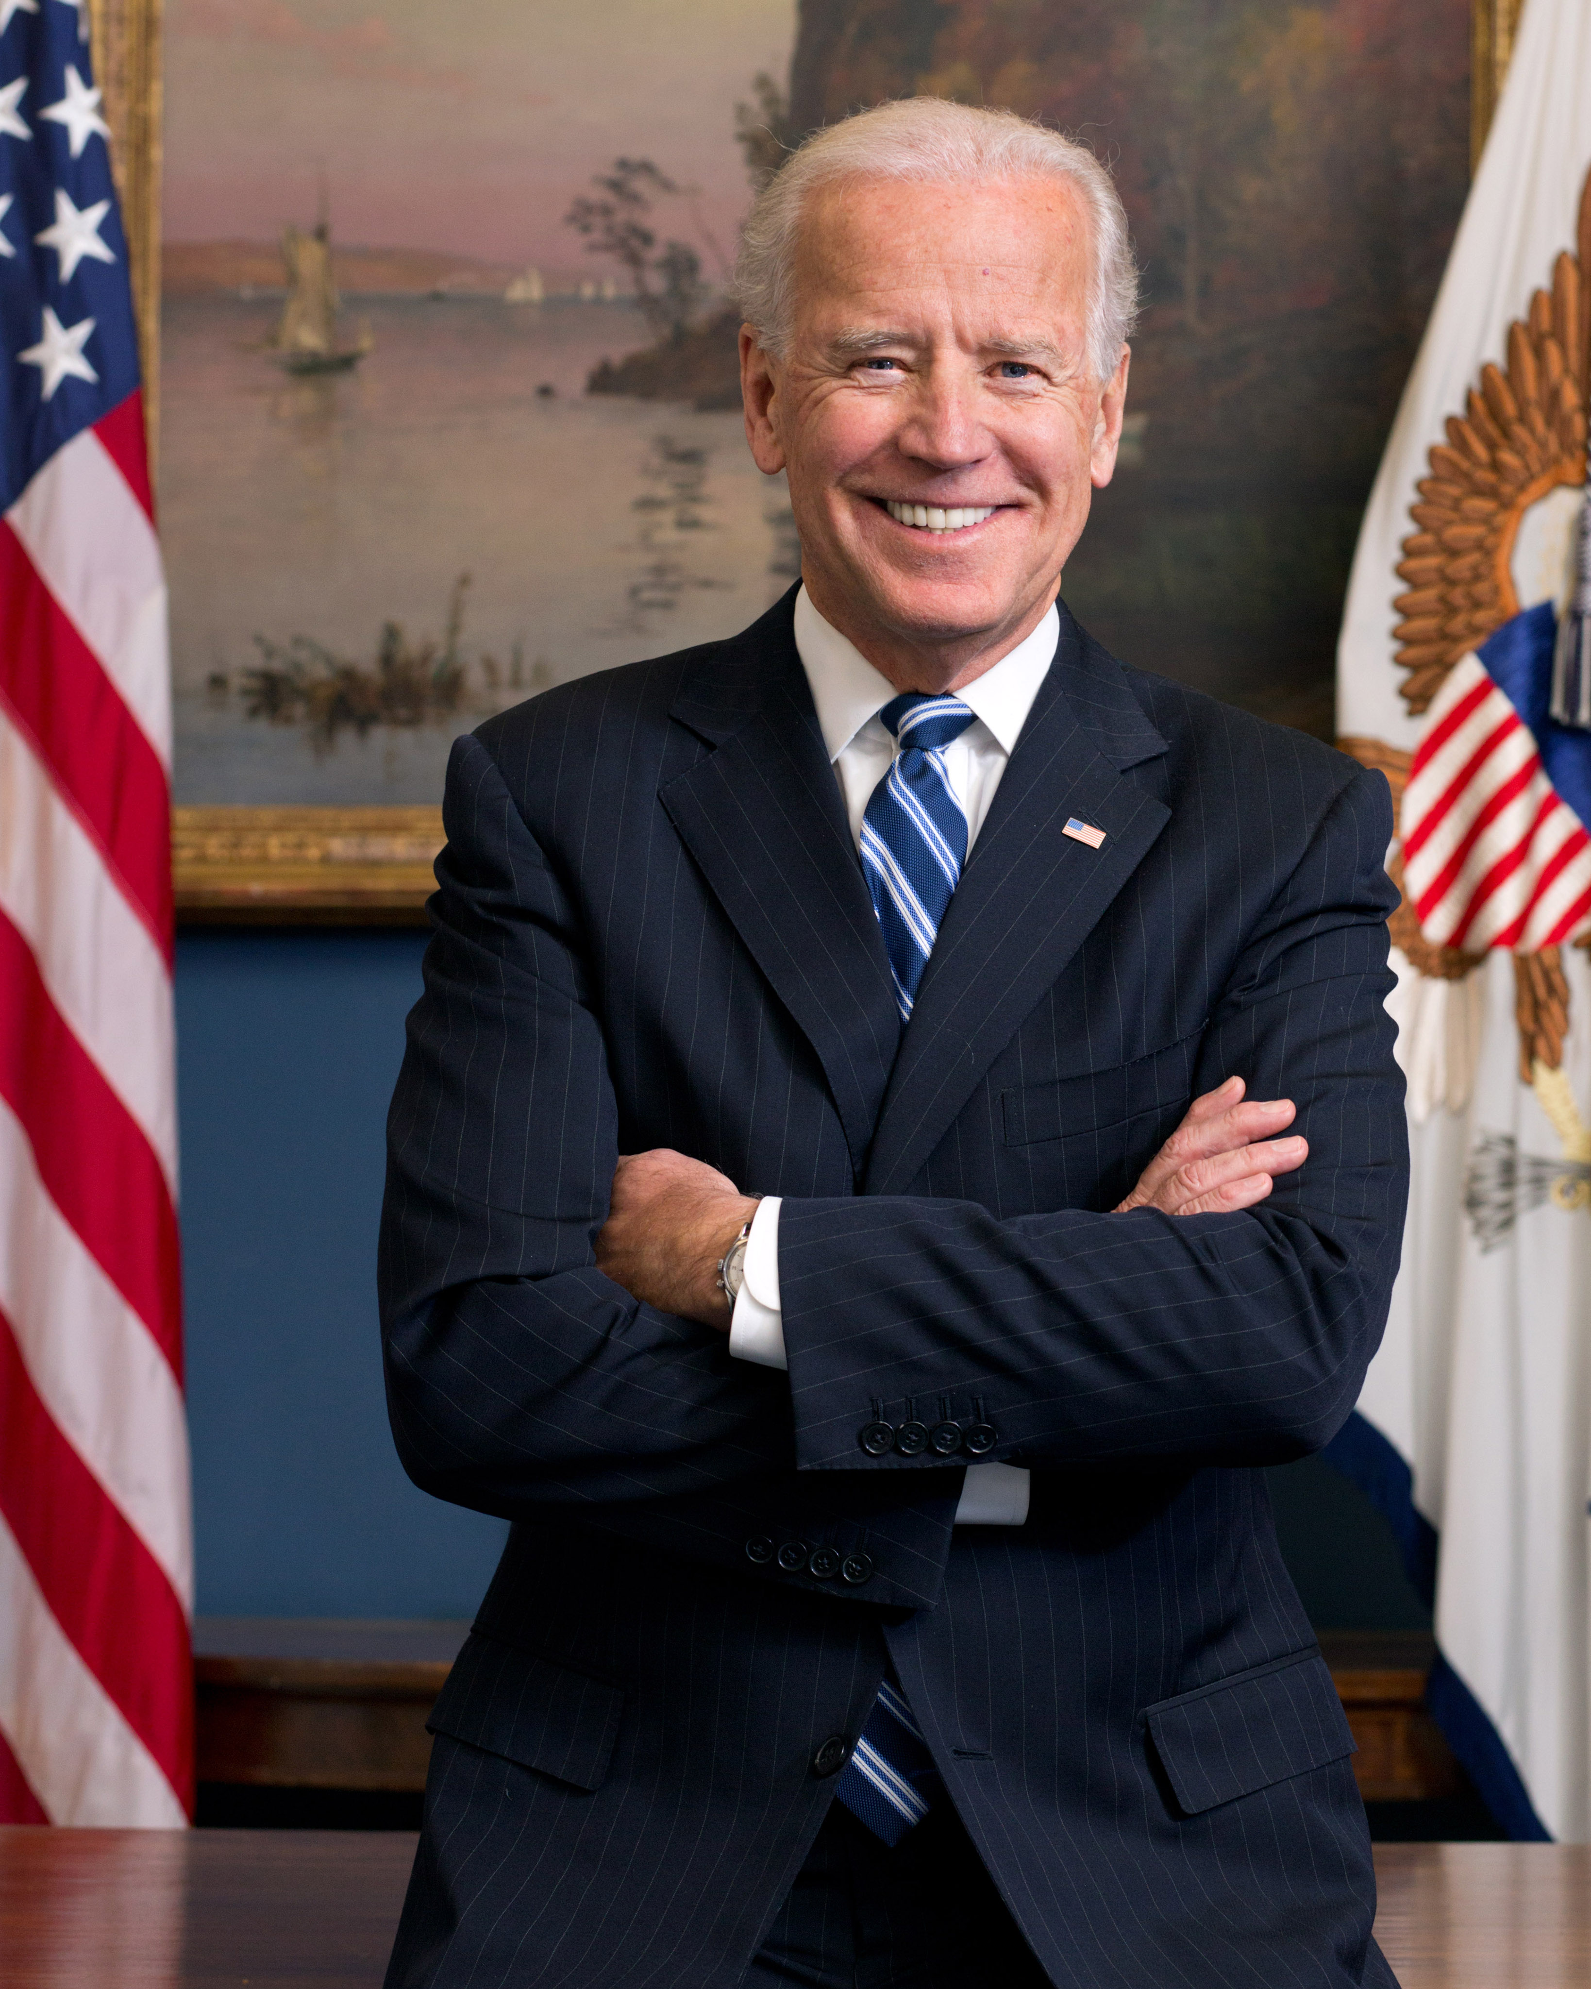
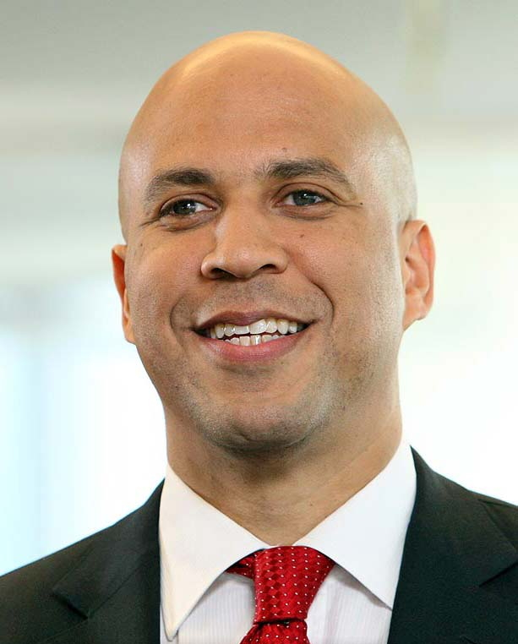
Pete Buttigieg
Andrew Yang
Bernie Sanders
Elizabeth Warren
Joe Biden
Cory Booker

Slide 4

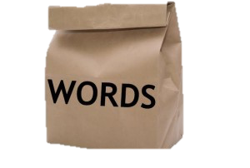
About Sentiment Analysis
What is it ?
Sentiment analysis is contextual mining of text which identifies and extracts subjective information in source material, and helping a business to understand the social sentiment behind the text
How it is done ?
Lexical Models
Bag of Words
Pretrained Tool
VADER
What is it ?

Slide 5
Data Streaming
Streamed from twitter using Spark Streaming and Tweepy
Data Streamed over a week
65,000 tweets collected
For 6 Candidates
Tweets filtered using user mentions and hashtags

Slide 6
Data Elements
Tweet
Device Information
Location Information

Slide 7
VADER (by nltk)
VADER (Valence Aware Dictionary and sEntiment Reasoner) is a lexicon and rule-based sentiment analysis tool that is specifically attuned to sentiments expressed in social media.
Provides 4 scores.
Probability of the text being Positive-Negative-Neutral
Compound Lexicon scores (-1 to 1)
Less than -0.05
-0.05 to 0.05
More than 0.05
Negative
Neutral
Positive

Slide 8

Results

Slide 9
Overall Sentiments
Devices used

Slide 10
Popular Hashtags
Distribution of Combined Sentiments
Hashtags﻿ | No of Occurrences
andrewyang | 1836
berniesanders | 602
kamalaharris | 582
ewarren | 460
msnbc | 335
petebuttigieg | 323
mindykaling | 196
joebiden | 172

Slide 11
Sentiment Distribution for Candidates

Slide 12
Other Insights
~ 50% tweets from California was positive for Andrew Yang (highest for candidate) .
~ 50% tweets from Texas was negative for Elizabeth Warren (highest for candidate).
California overall had the highest share of tweets.
Texas and Florida appeared to be foremost for negative tweets.
Washington and New York were the front runner in positive tweets.

Slide 13
Evaluating the Sentiment using a Bag of words model and comparing the results
Analyzing the sentiment of tweets made BY the candidates and using it to explain the sentiment of the public towards the candidate.
Future Work

Slide 14

Thank you for your attention.
Any Questions ?
[This is the part where you say No!! ]

